Slide 1
RMSE OF DRUGS

Slide 2
Parameter
1 Molecular Weight (g/mol)
2 pKa
3 Log P
4 Log S
5 Polar Surface Area (Å2)
6 Polarizability (Å3)
7 HOMO (eV)
8 LUMO (eV)
9 Ionization Energy (eV)
10 Electron Affinity (eV)
11 Electronegativity (eV)
12 Hardness (eV)
13 Electrophilicity (eV)
14 N_Fe

Slide 3
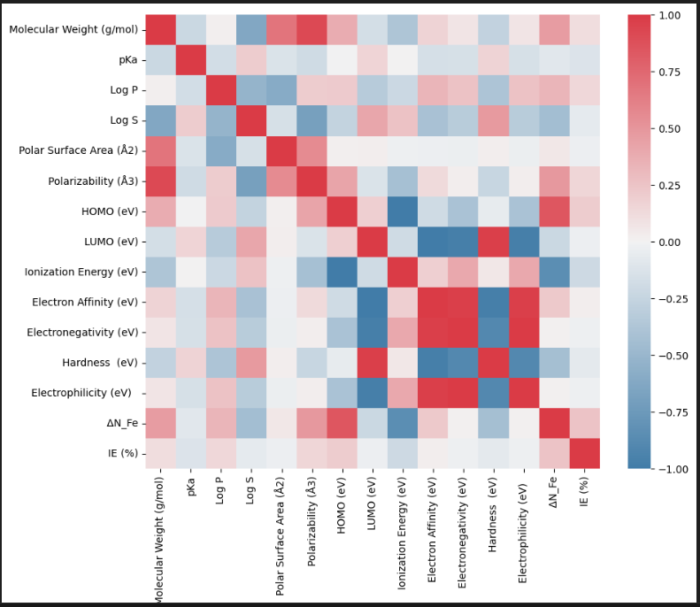
Heat map

Slide 4
Linear Regression
MSE: 23.8460
MAE: 4.3251
RMSE: 4.8832
R² Score: 0.1262
Training Time: 18.54 ms

Slide 5
Ridge Regression
MSE: 23.7368
MAE: 4.4199
RMSE: 4.8720
R² Score: 0.1302
Training Time: 10.11 ms

Slide 6
Lasso Regression
MSE: 22.1330
MAE: 4.3721
RMSE: 4.7046
R² Score: 0.1890
Training Time: 4.22 ms

Slide 7
ElasticNet Regression
MSE: 22.2560
MAE: 4.3662
RMSE: 4.7176
R² Score: 0.1845
Training Time: 0.00 ms

Slide 8
Decision Tree Regression
MSE: 25.0818
MAE: 4.3643
RMSE: 5.0082
R² Score: 0.0810
Training Time: 7.78 ms

Slide 9
Random Tree Regressor
MSE: 23.2804
MAE: 3.9891
RMSE: 4.8250
R² Score: 0.1470
Training Time: 200.15 ms

Slide 10
Gradient Boosting Regressor
MSE: 21.5214
MAE: 3.8178
RMSE: 4.6391
R² Score: 0.2114
Training Time: 199.98 ms

Slide 11
SVR
MSE: 28.4957
MAE: 4.7673
RMSE: 5.3381
R² Score: -0.0441
Training Time: 9.19 ms

Slide 12
KNN Regressor
MSE: 30.2701
MAE: 4.9917
RMSE: 5.5018
R² Score: -0.1092
Training Time: 0.22 ms

Slide 13
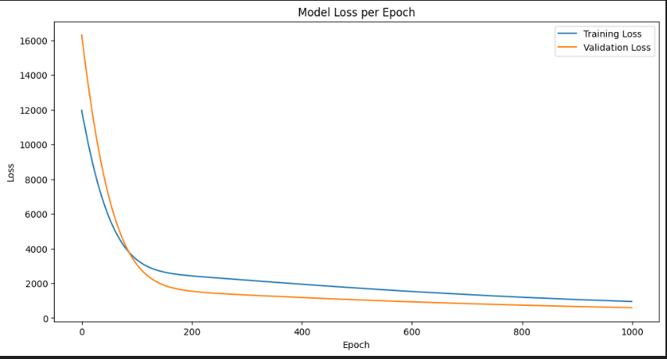
Single Perceptron
MSE: 589.7070
MAE: 22.0996
RMSE: 24.2839
R² Score: -20.6081
Training Time: 140874.84 ms

Slide 14
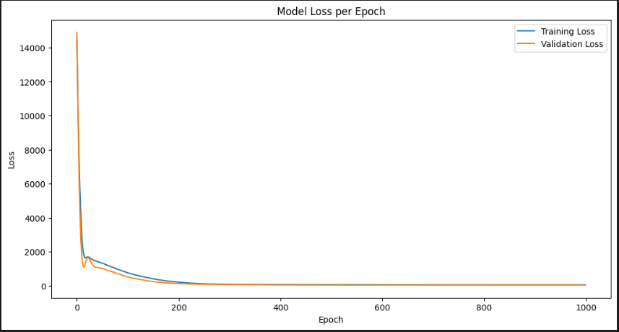
Single Layer Perceptron
MSE: 37.0996
MAE: 5.5161
RMSE: 6.0909
R² Score: -0.3594
Training Time: 128787.26 ms

Slide 15
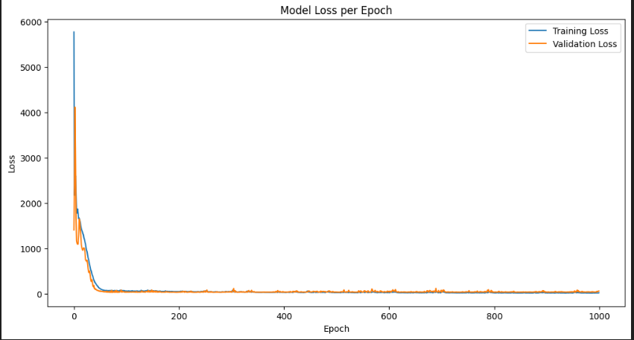
Multi Layer Perceptron
MSE: 57.1461
MAE: 6.3174
RMSE: 7.5595
R² Score: -1.0940
Training Time: 122499.71 ms

